Slide 1
DBMS Final Project: Restaurant
Team Members
Kanakapriya Krishnakumar
Mehek Khan
Rita Zaidan
Aanchal Narad

Slide 2
ENTITIES-
RESTAURANT
ITEM
CUSTOMER
BILL

Slide 3
RELATIONSHIPS-
restaurant MAKES item
customer DINES_IN restaurant
customer ORDERS item
customer PAYS bill

Slide 4
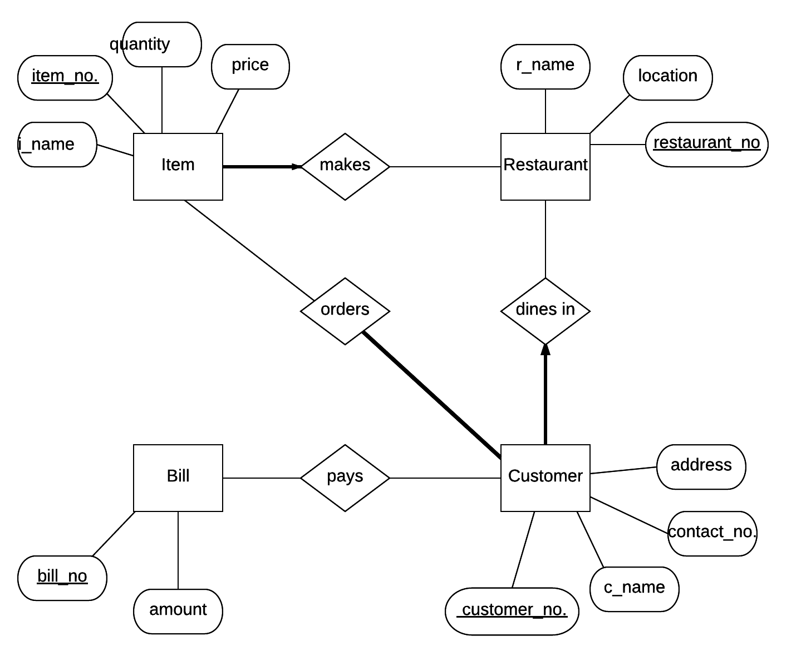
ER Diagram

Slide 5
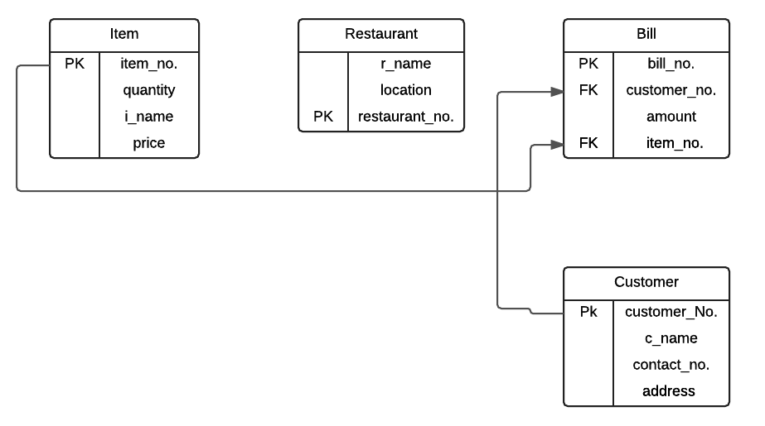
Logical Schemas

Slide 6
Create Table- Item
CREATE TABLE Item (
item_no INTEGER NOT NULL PRIMARY KEY,
quantity INTEGER NOT NULL,
i_name CHAR(20) NOT NULL,
price integer NOT NULL );

Slide 7
Create Table- CUSTOMER
CREATE TABLE Customer(
customer_no CHAR(20) NOT NULL PRIMARY KEY,
c_name CHAR(20) NOT NULL,
contact_no CHAR(20) NOT NULL ,
address VARCHAR(100)
);

Slide 8
Create Table- RESTAURANT
CREATE TABLE Restaurant (
restaurant_no CHAR(20) NOT NULL PRIMARY KEY,
r_name CHAR (30) NOT NULL,
location VARCHAR(100) NOT NULL
);

Slide 9
Create Table- BILL
CREATE TABLE Bill(
bill_no INTEGER NOT NULL PRIMARY KEY,
amount DOUBLE NOT NULL,
customer_no NOT NULL CHAR(20),
item_no NOT NULL INTEGER,
FOREIGN KEY (item_no) REFERENCES Item(item_no) ON DELETE NO ACTION,
FOREIGN KEY (customer_no) REFERENCES Customer(customer_no) ON DELETE NO ACTION
);

Slide 10
Create Table- MAKES
CREATE TABLE Makes(
restaurantNo NOT NULL CHAR(20),
itemNo NOT NULL INTEGER,
PRIMARY KEY (restaurantNo, itemNo),
FOREIGN KEY (itemNo) REFERENCES Item(item_no) ON DELETE NO ACTION,
FOREIGN KEY (restaurantNo) REFERENCES Restaurant(restaurant_no) ON DELETE NO ACTION
);

Slide 11
Create Table- ORDERS
CREATE TABLE Orders(
item_no_o NOT NULL INTEGER,
customer_no_o NOT NULL CHAR(20),
PRIMARY KEY (customer_no_o, item_no_o),
FOREIGN KEY (customer_no_o) REFERENCES Customer(customer_no) ON DELETE NO ACTION,
FOREIGN KEY (item_no_o) REFERENCES Item(item_no) ON DELETE NO ACTION
);

Slide 12
Create Table- PAYS
CREATE TABLE Pays(
bill_no_no INTEGER NOT NULL,
customer_no_no CHAR(20) NOT NULL,
PRIMARY KEY (bill_no_no, customer_no_no),
FOREIGN KEY (bill_no_no) REFERENCES Bill(bill_no) ON DELETE CASCADE,
FOREIGN KEY(customer_no_no) REFERENCES Customer(customer_no_no) ON DELETE NO ACTION
);

Slide 13
Create Table- DINES IN
CREATE TABLE Dines_In(
customer_n CHAR(20) NOT NULL,
restaurant_n CHAR(20) NOT NULL,
PRIMARY KEY (customer_n, restaurant_n),
FOREIGN KEY (customer_n) REFERENCES Customer(customer_no) ON DELETE NO ACTION,
FOREIGN KEY (restaurant_n) REFERENCES Restaurant(restaurant_no) ON DELETE NO ACTION
);

Slide 14
Example- how many customers dine in each restaurant
SELECT restaurant_n, count(restaurant_n)
FROM Dines_In
WHERE customer_n = ANY(SELECT customer_n FROM Customer WHERE customer_no>5)
GROUP BY restaurant_n
Order by count(restaurant_n);

Slide 15
Example- what items were made in this restaurant
SELECT I1.i_name
FROM Item I1
WHERE I1.item_no IN (SELECT M1.itemNo
FROM Makes M1
WHERE M1.restaurantNo = '\'415-123-4567\''
and M1.itemNo=I1.item_no);

Slide 16
Examples- what items are made at this restaurant
SELECT I1.i_name
FROM Item I1
WHERE Exists (select *
FROM Makes M1
WHERE M1.restaurantNo = '\'415-222-4467\'' and M1.itemNo=I1.item_no);

Slide 17
Examples- Item numbers of bill amount over $60
SELECT I1.item_no
FROM Item I1
WHERE Exists(SELECT *
FROM Bill B1
WHERE B1.amount>60 and B1.item_no=I1.item_no);

